Slide 1
Dr. Care

Slide 2
INTRODUCTION
This project deals with the Corporate Medicare Management. This project is very helpful to both Medicare staff as well as to the public. It is having mainly Administration and Client modules.
The growing quality demand in the hospital sector makes it necessary to exploit the whole potential of stored data efficiently, not only the clinical data, in order to improve diagnoses and treatments, but also on management, in order to minimize costs and improve the care given to the patients.
However, data mining and the overall process, known as Knowledge Discovery from Databases (KDD), is usually an expensive process, especially in the stages of business objectives elicitation, data mining objectives elicitation, and data preparation. This is especially the case each time data mining is applied to a hospital: many meetings have to been held with the direction of the hospital, area coordinators, computer scientists, etc., to establish the objectives, prepare the data, the mining views and for training the users to general DM tools.

Slide 3
SCOPE
Existing System Features
Integration of Corporate Medicare centers is very difficult while it is having different branches.
In most of the cases the database is similar from one hospital to another hospital. In those cases also we can’t easily adapt a new technology in the new hospital.
It is very difficult to analyze the usage percentage of hospital resources, Bed occupation Ratio, Administration, Laboratory information even in a single center. Then we can expect the complexity while integrating multi multi-specialty Medicare Centers.
Room Reservations, Doctor Appointment Schedules, Operation Schedules, and Medicine indentation information is very difficult to maintain and share among the different Medicare Centers.
Lack of generic and unique model we have to implement the same set of data model for every newly established Medicare Center.

Slide 4
Proposed System Features
In this project we are trying to implement which parts of a data-mining project for hospital management are equal or highly similar across different hospitals (at least in the same national healthcare system). This allows us to design several data mining modules, which can be portable across several hospitals, thus dramatically reducing the time to implement a data-mining program in a new hospital.

Slide 5
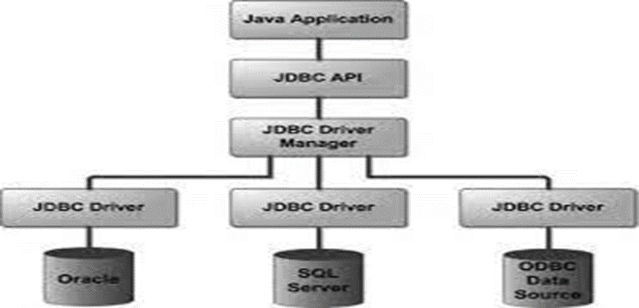
Database for Dr. Care
Managing Dr. Care's Java and MySQL data items requires a systematic approach that includes designing a database schema, establishing a connection between Java and MySQL, creating CRUD (Create, Read, Update, Delete) operations, and implementing error handling mechanisms. The first step is to design a database schema that represents the different data items, such as doctors, patients, appointments, and medical records, and define their relationships. Next, establish a connection between Java and MySQL using JDBC (Java Database Connectivity) driver and write code to create, read, update, and delete data items from the database. It is also important to implement proper error handling mechanisms, such as handling exceptions, logging errors, and providing meaningful error messages to users. By following these steps, Dr. Care's Java and MySQL data items can be effectively managed and provide a reliable and efficient system for managing medical records and appointments.

Slide 6
SYSTEM ANALYSIS
Requirement Analysis
A requirement is a feature that must be included in the system. Before the actual design and implementation start, getting to know the system to be implemented is of prime importance.
Main emphasis should be on:
Inputs enter into the system.
Standard Encryption of Input on submit
The outputs expected from the system.
The people involved in the working of the system.
The volume of DATA (INPUT) and the amount of Information (OUTPUT) that will be involved with respect to the system itself, the following facts should be taking into consideration.

Slide 7
Software Requirement Specification
OPERATING SYSTEM : WIN 98/2000/XP, UNIX/LINUX
DATA BASE : MYSQL
SOFTWARE : APACHE TOMCAT
FRONT END TOOL : DHTML
SCRIPTING LANGUAGE : JAVA SCRIPT
WEB COMPONENTS : JSP
DATA MINING TOOL : WEKA

Slide 8
Hardware Requirements Specification
PROCESSOR : Pentium-IV
PROCESSOR SPEED : 2.4GHZ
MONITOR : COLOR MONITOR
HARD DISK : 40GB
RAM : 512MB
MOUSE : SCROLLING MOUSE
KEY BOARD : MM KEYBOARD

Slide 9
Requirement Study
The origin of most software systems is in the need of a client, who either wants to automate and existing manual system or desires a new software system. The software system itself is created by the developer finally the completed system will be used by the end user. Thus, there are three major parties interested in a new system: the client, the users, and the developer. The requirements for the system that will satisfy the need of the clients and the concerns of the user have to communicate to the developer.
The problem is that the client usually does not understand software or the software development process, and the developer often does not understand the clients problem and application area. This causes a communication gap between the parties involved in the development project. A basic purpose of software requirement specification is to bridge this communication gap. SRS is the medium through which the client and the user need are accurately specified; indeed SRS forms the basis of software development. A good SRS should satisfy all the parties-something very hard to achieve and involves trade-offs and persuasion.

Slide 10
Feasibility Study
Feasibility is an important phase in software development process. It enables the developers to have an assessment of the product being developed. It refers to the feasibility study of product in terms of outcomes of the product, operational use and technical support required for implementation it.
1. Economic Feasibility
2. Operational Feasibility
3. Technical Feasibility

Slide 11
Economic Feasibility
It refers to the benefits or outcomes we are deriving from the product as compared to the total cost we are spending for developing the product.
In the present system, the development of new product greatly enhances the accuracy of the system and reduces the delay in the processing of applications and generating the reports. The errors can be greatly reduced and at the same time providing the great level of security. Here we don’t need additional equipment except memory of required capacity. No need for spending money on client for maintenance because the database used is web enabled database.

Slide 12
Operational Feasibility
It refers to the feasibility of the product to be operational. Some products may work very well at design and implementation but may fail in the real time environment. It includes the study of human required and their technical expertise.
In the present system, the entering the details, updating the details and reports generations are perfect and quick in operations.

Slide 13
Technical feasibility
It refers to whether the software that is available in the market fully supports the present application .It studies the pros and cons of using particular software for the development and its feasibility. It also studies the additional time needed to be given to people to make the application work.
In the present system the user interface is user friendly and does not require much expertise and training .It just needs mouse click to do operations and to generate reports. The software that is used for developing is highly suitable for the present applications since the users

Slide 14
SYSTEM DESIGN
System design is the process, which involves conceiving planning and carrying out the plan by generating the necessary reports and inputs. In other words design phase acts as bridge between the software requirement specification and implementation phase, which satisfies those requirements. System design is the transformation of the analysis model into a system design model.
The design of the system is correct if a system built precisely according to the requirements of that system. Design should be clearly verifiable, complete and traceable. The goal is to divide the problem into manageably small modules that can be solving separately. The different modules have to cooperate and communicate together to solve the problem. The complete project is broken down into different identifiable modules. Each module can be understood separately. All the modules at last are combined to get the solution of the complete system.

Slide 15
Use case Diagram for Patient

Slide 16
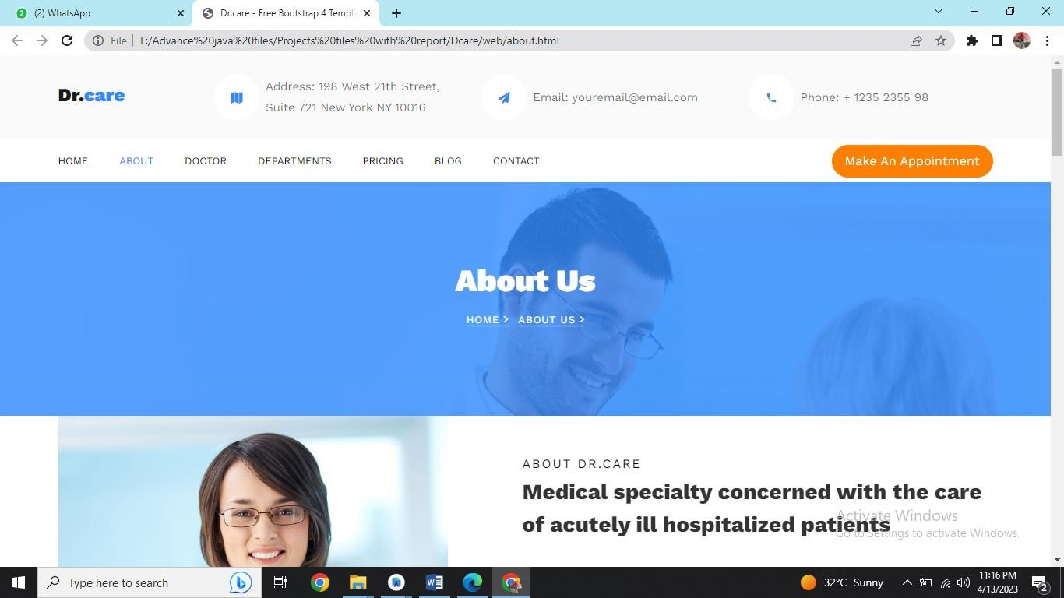
OUTPUT SCREENS
OUTPUT SCREENS

Slide 17
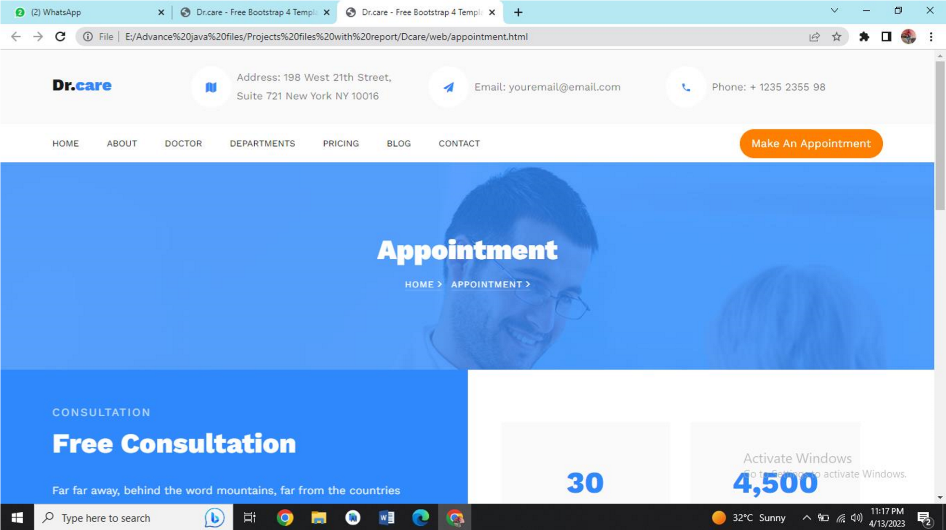
Appointment page

Slide 18
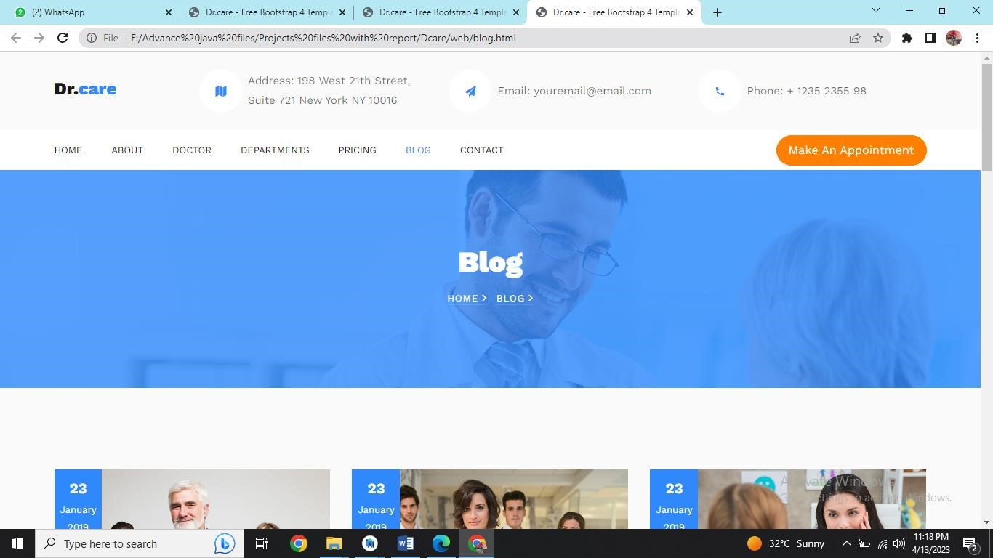
Blog Page

Slide 19
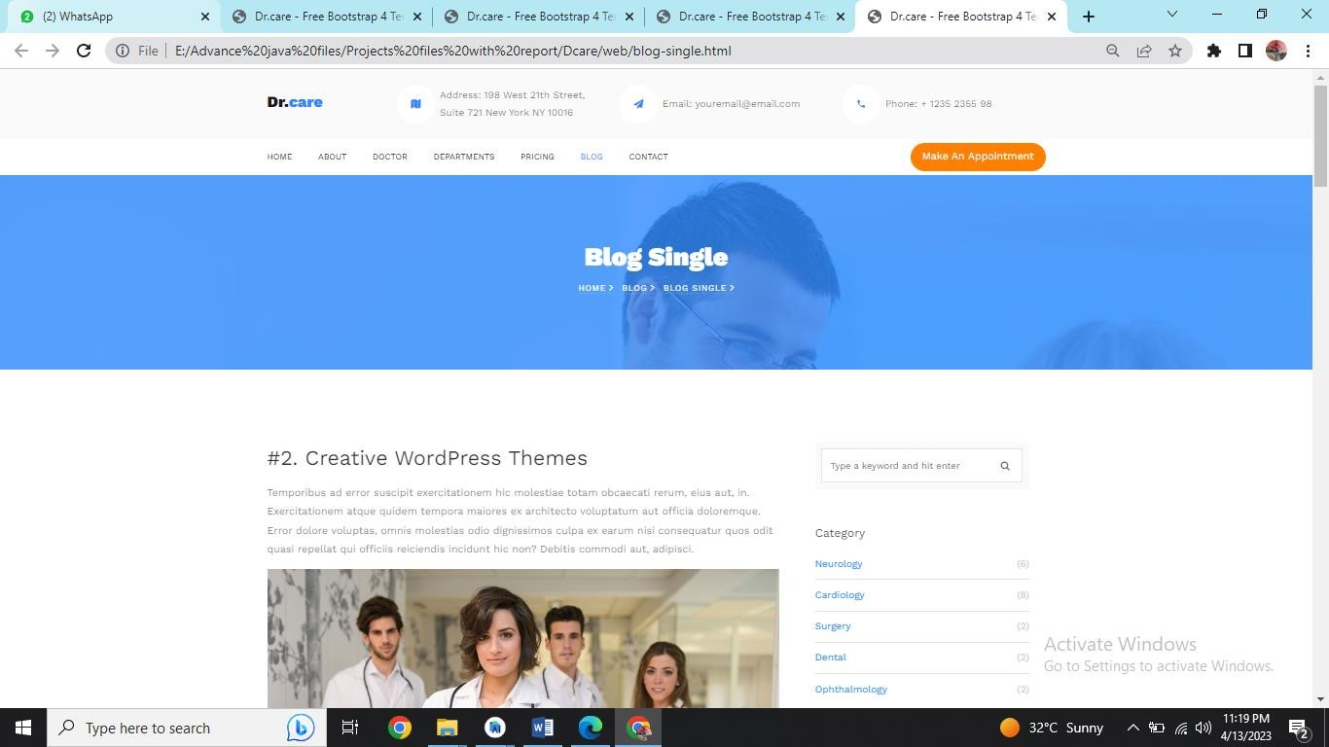
Blog- single page

Slide 20
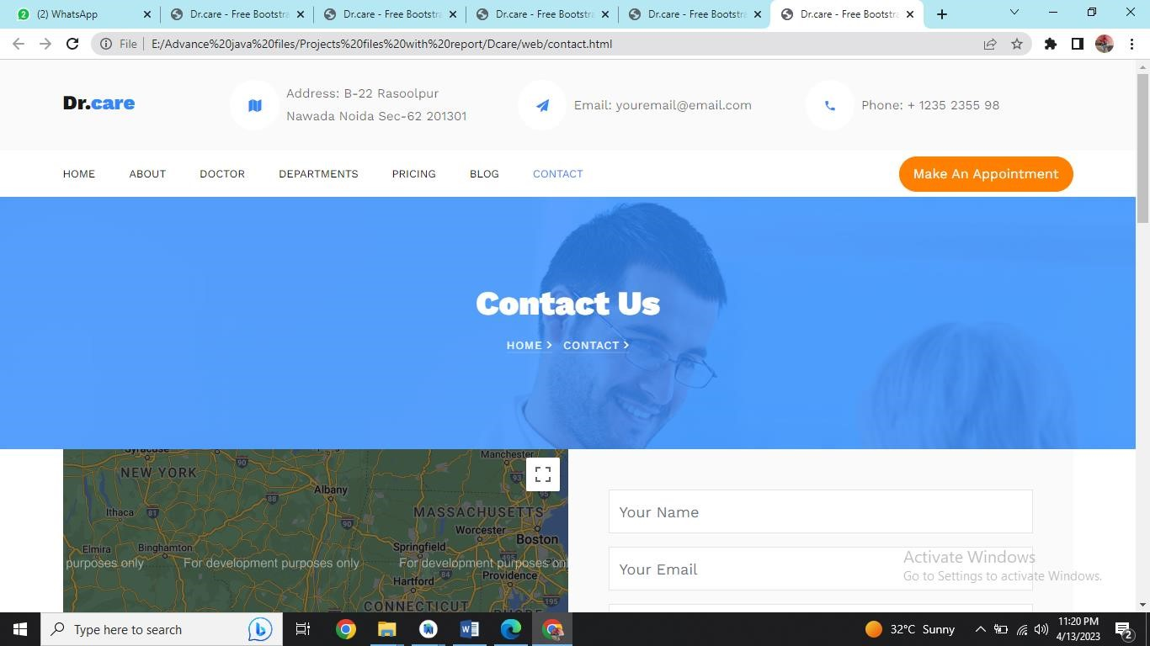
Contact us page

Slide 21
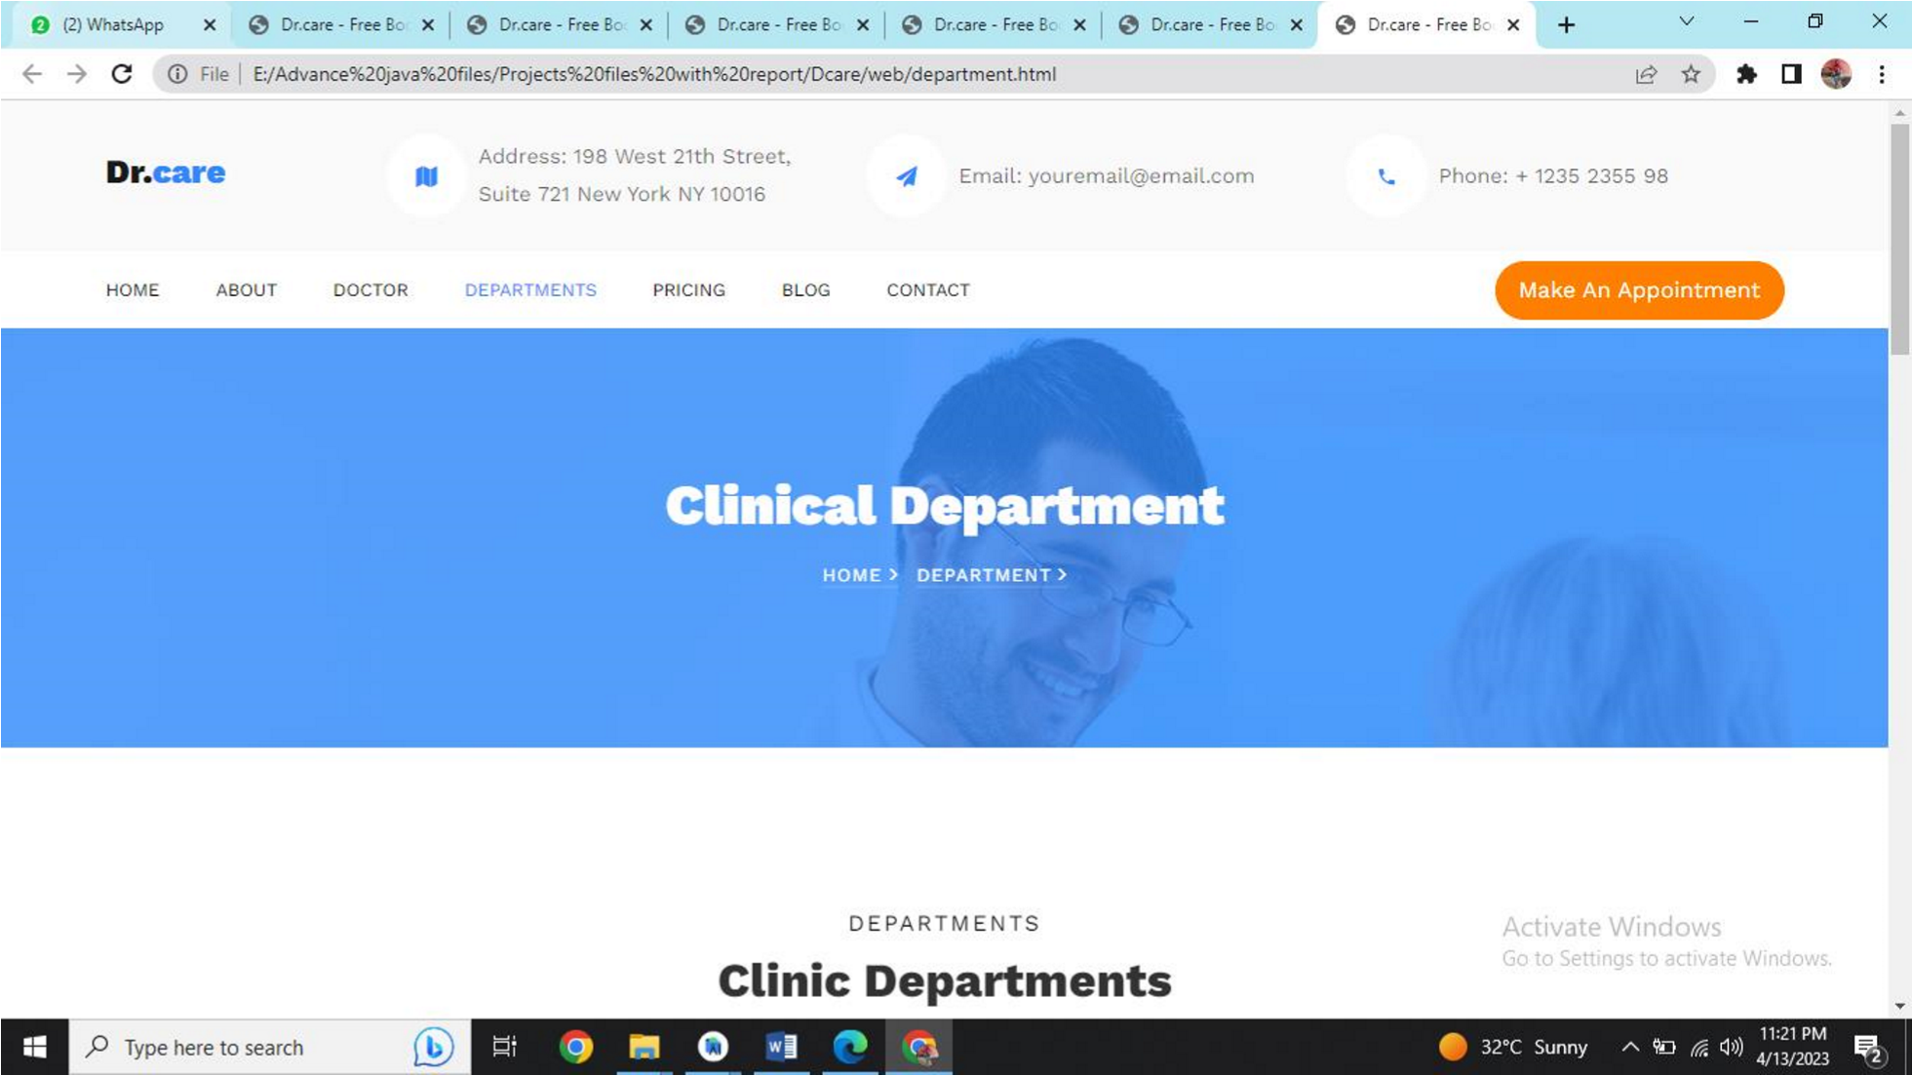
Department page

Slide 22
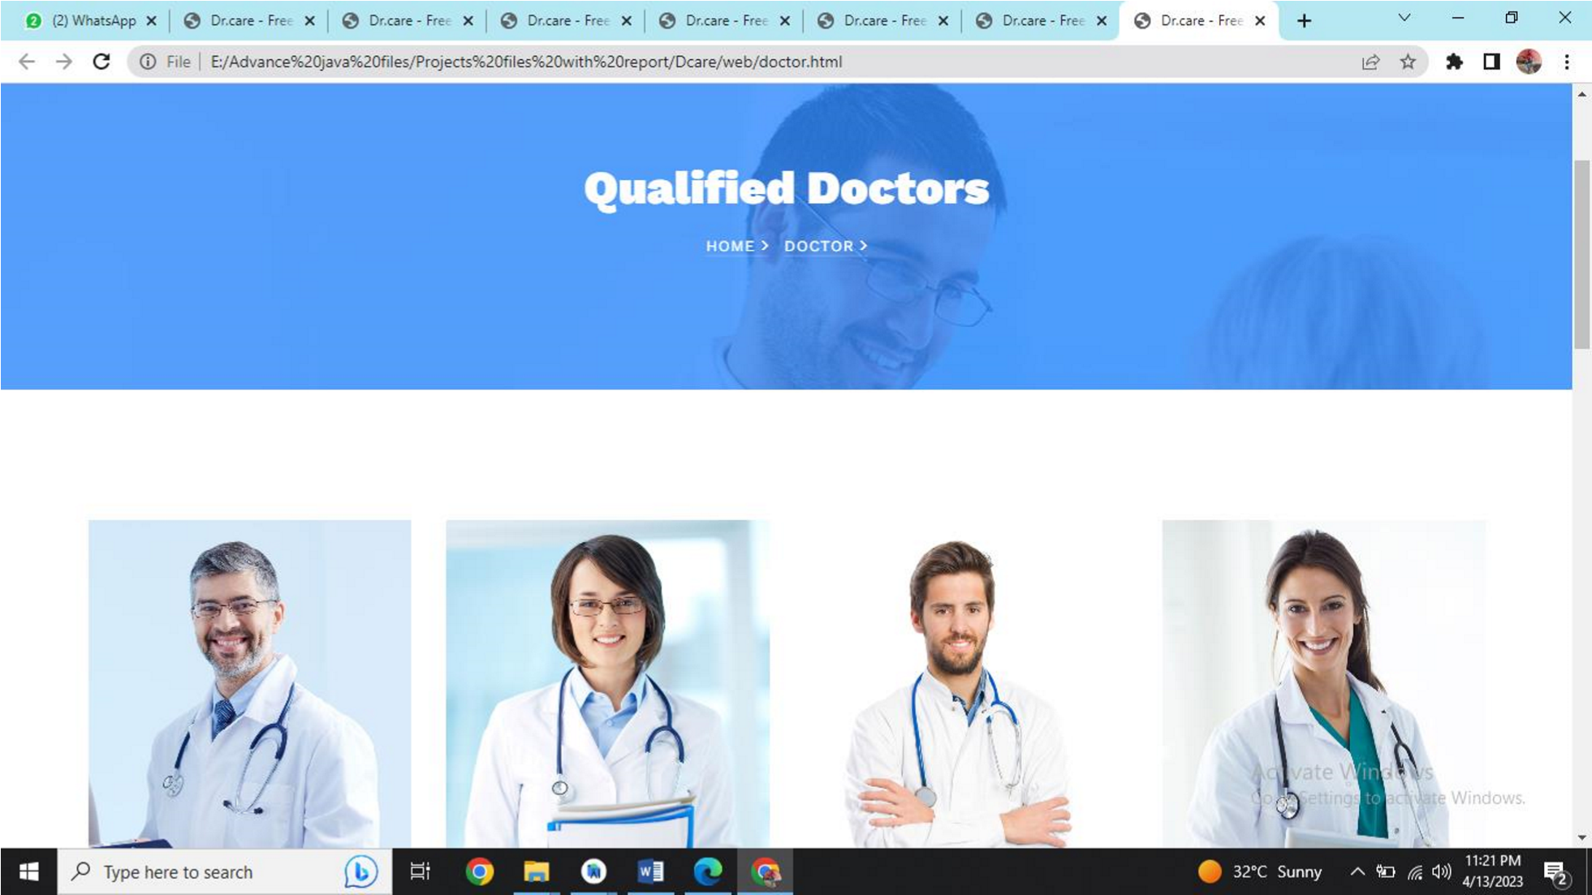
Doctors

Slide 23
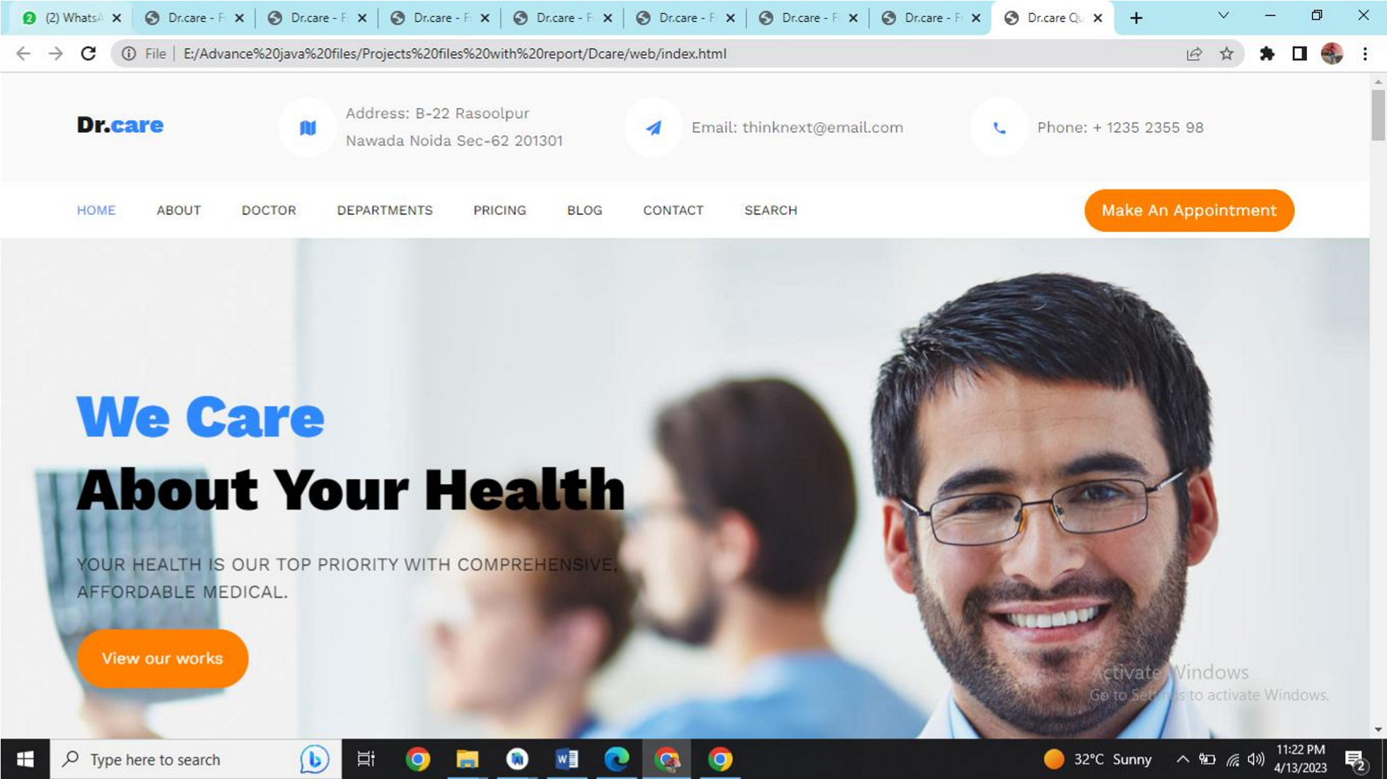
Index Page

Slide 24
references:-
https://www.w3schools.com
https://hi.wikipedia.org
https://www.geeksforgeeks.org
https://en.wikipedia.org
https://developer.mozilla.org
https://www.javascript.com
https://www.geeksforgeeks.org
https://www.codecademy.com
https://www.javatpoint.com
https://getbootstrap.com

Slide 25
THANKING YOU

